Slide 1
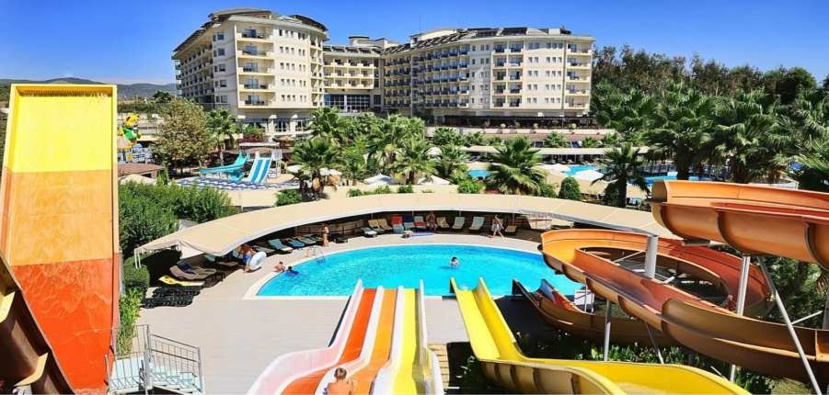
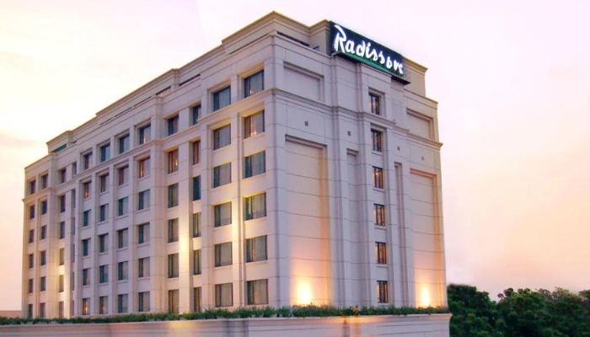
Capstone Project
Hotel Booking Analysis
Presented By –
Khushboo Kant
Ankita Singh
Prasant Gour
Akhand Pratap Singh
Manish Kumar Sharma

Slide 2
Points to Discuss:
Agenda
Data summary
Hotel wise analysis
Distribution Channel wise analysis
Booking cancellation analysis
Timewise analysis
Conclusion

Slide 3
Agenda
.
We’ll be doing analysis of given data set in following ways→ follow the bullet point.
Hotel wise analysis
Distribution Channel wise analysis
Booking cancellation analysis
Timewise analysis
By doing this we’ll try to find out key factors driving the hotel bookings trends.

Slide 4
Data Summary
Given data set has different columns of variables crucial for hotel bookings. There are different columns in the given data set that contain variables that are crucial for hotel bookings.
Here are some of them:
hotel: A hotel can be classified as either a resort hotel or a city hotel.
is_cancelled : Values in the column indicate what type of cancellation it was. Cancellation or non-cancellation of the booking.
Values[0,1], where 0 indicates not cancelled.
lead_time : Approximately how long it takes between making a reservation and arriving.
stayed_in_weekend_nights: Per reservation, the number of weekend nights
stayed_in_weekday_nights: Reservations for weekday nights.
Country: Guest's country of origin.

Slide 5
Data Summary(contd..)
market_segment: This column show how reservation was made and what is the purpose
of reservation. Eg, corporate means corporate trip, TA for travel agency.
distribution_channel: The medium through booking was made.[Direct,Corporate,TA/TO,undefined,GDS.]
Is_repeated_guest: Shows if the guest is who has arrived earlier or not.Values[0,1]-->0
indicates no and 1 indicated yes person is repeated guest.
days_in_waiting_list: Number of days between actual booking and transact.
customer_type: Type of customers( Transient, group, etc.)

Slide 6
Hotel wise Analysis
While doing hotel-wise analysis of given hotel booking dataset, we answered following questions:
Percentage of bookings in each hotels?
Which hotel makes more revenue?
Which hotel has higher lead time?
For which hotel, does people have to wait longer to get a booking confirmed?
Which hotel has higher booking cancellations rate?

Slide 7
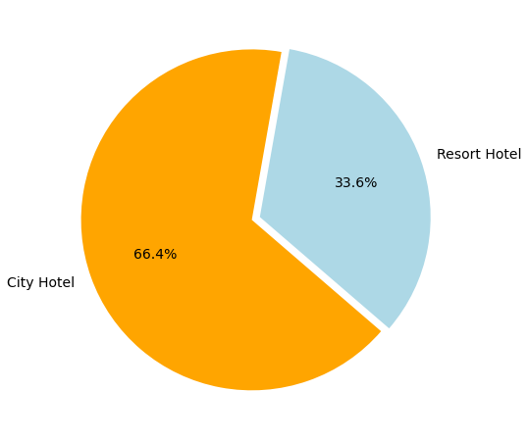

Slide 8
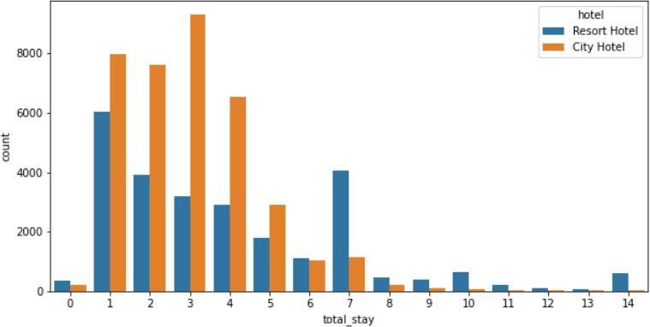
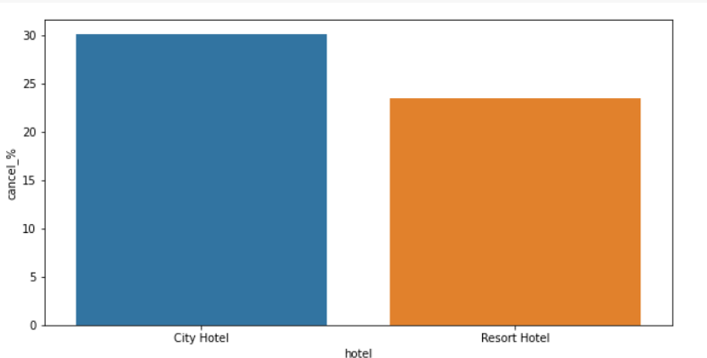
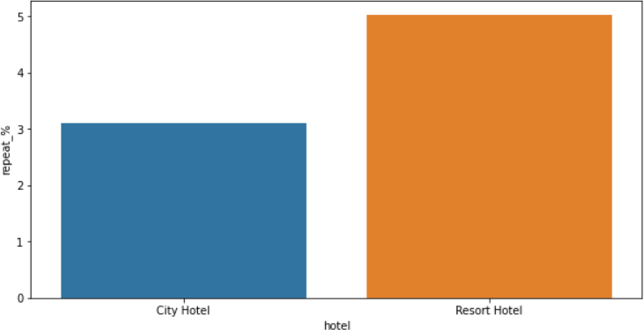
Most of stays are less than 5 days. There are very few long stays at hotels but Resort Hotel is preferred for long stays.
Almost 30 % of City Hotel bookings and 25 % of Resort hotel bookings got canceled.
Both hotels have very small percentage that customer will repeat, but Resort hotel has slightly higher repeat % than City Hotel.

Slide 9
Distribution channel wise Analysis
While doing Distribution channel wise analysis of given hotel booking dataset, we answered
following questions:
Which is the most common channel for booking hotels?
Which distribution channel brings better revenue generating deals for hotels?

Slide 10
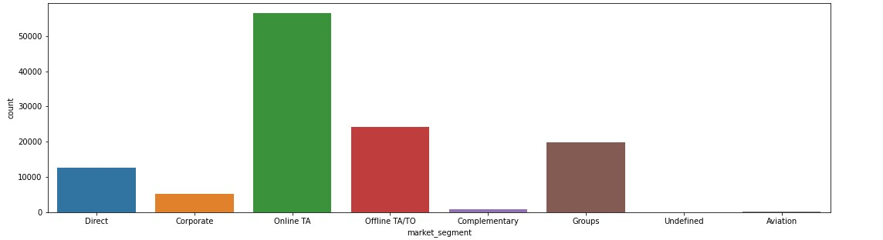
Distribution channel wise Analysis
Online TA(travel agent) is the most common channel for booking hotels compare than other hotels.
Here we can see that most number of guest are making reservation through TA/TO channels which is travel agent and tour operator.

Slide 11
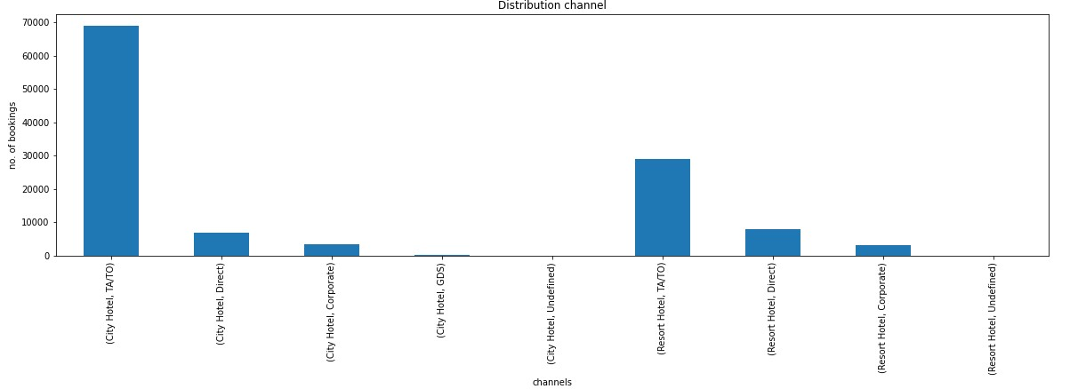
Resort hotel has more revenue generating deals by direct and TA/TO channel. Resort hotel need to increase outreach on GDS to increase revenue.
GDS channel brings higher revnue generating deals for city hotel. City hotel can work to increase outreach on GDS channel to get more higher revenue generating deal
.

Slide 12
Booking cancellation Analysis
We analyze the following possible reasons for booking cancellations:
Which significant distribution channel has highest cancellation percentage?
Longer lead time.
Longer time (in days) in waiting list.
Not getting same room as reserved.
Does not getting same room as reserved effects adr?

Slide 13
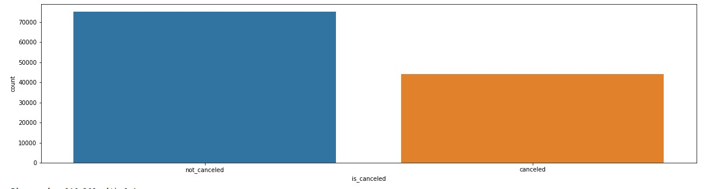
Blue colour stands for City hotel.
Orange colour stands for Resort hotel.
So far, we can conclude here that City hotel has higher booking cancellations rate than Resort hotel.

Slide 14
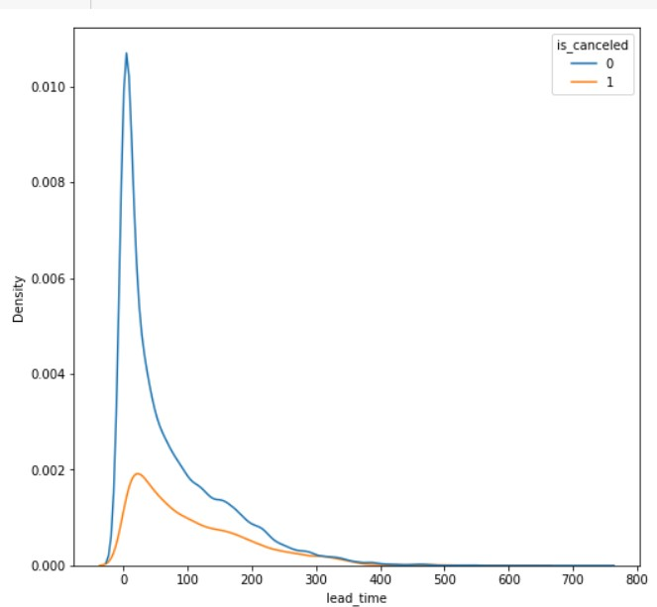
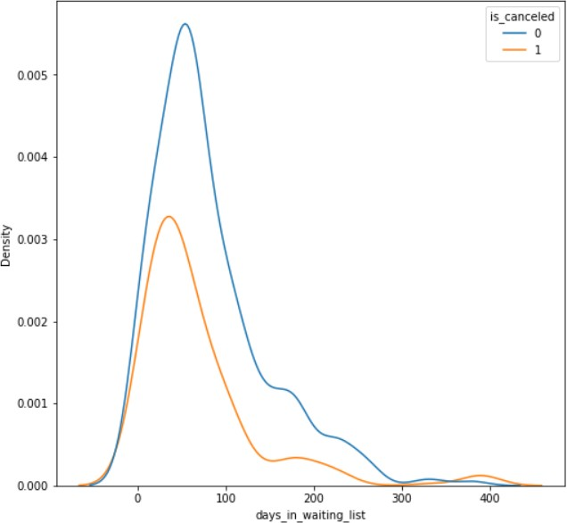
Most of the bookings that are cancelled have waiting period of less 150 days but also most of bookings that are not cancelled also have waiting period of less than 150 days. Hence this shows that waiting period has no effect on cancellation of bookings.
Also, lead time has no effect on cancellation of bookings, as both curves of cancellation and not
cancelation are similar for lead time too.

Slide 15
Time-wise Analysis
While doing time-wise analysis of given hotel booking dataset, we answered following questions:
What are the most busy months for hotels?
In which months hotels charges higher adr?
How does booking numbers and adr changes within a month?
How does bookings varies along year for different types of customers.

Slide 16
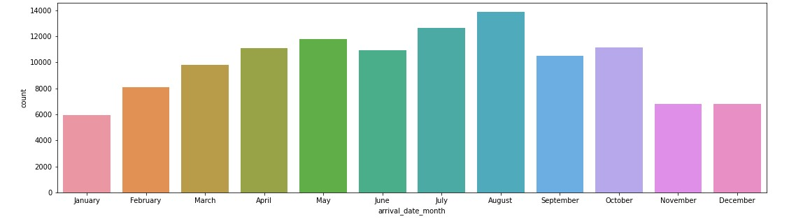
What are the most busy month of hotels?

Slide 17
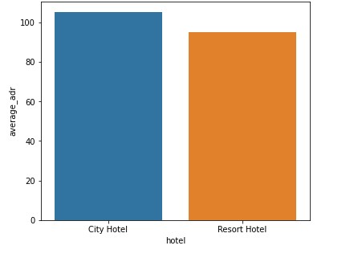
Which hotel charges highest Average Daily Rate?
City hotel charges more average daily rate because it is more in demand and on the other hand Resort hotel charges less average daily rate as it is in less demand.

Slide 18
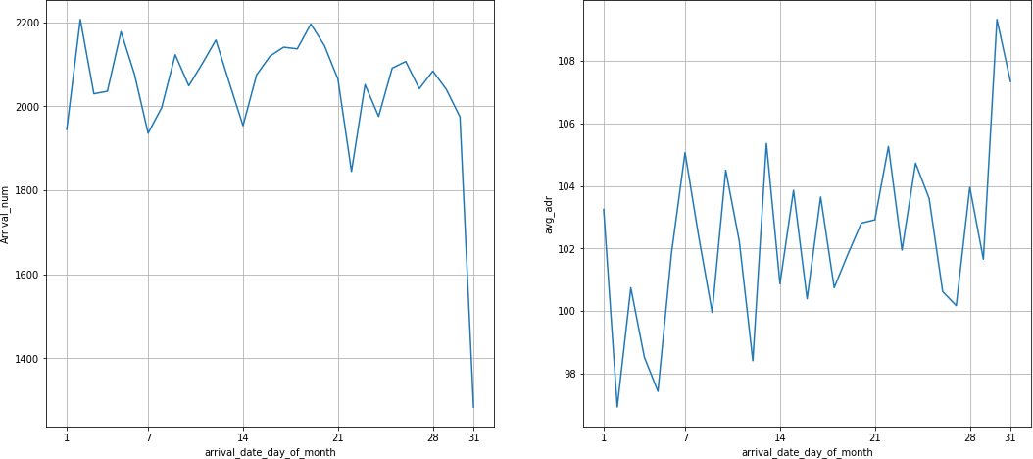
We can see that graph Arrival_num has small peaks at regular interval of days. This can be due to increase in arrival weekend.
Also, the avg adr tends to go up as month ends. Therefore charges are more at the end of month.

Slide 19
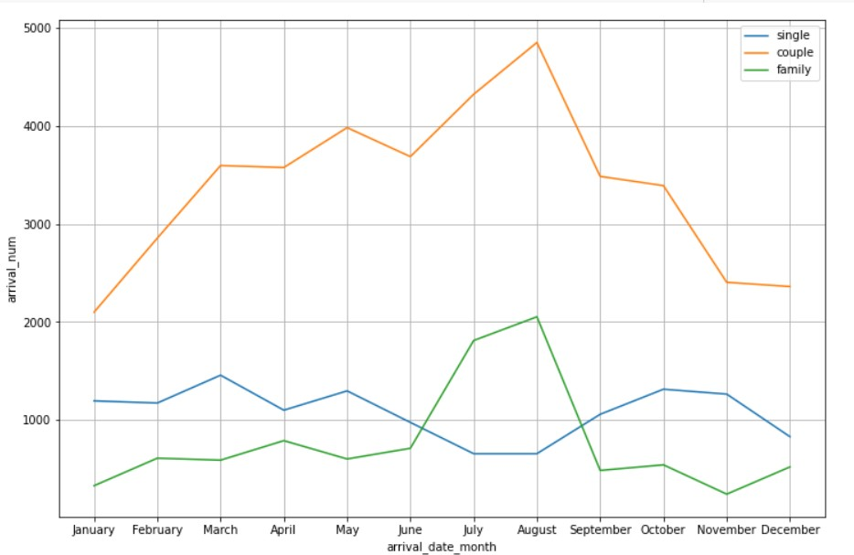
Mostly bookings are done by couples.
It is clear from graph that there is a sudden surge in arrival num of couples and family in months of July and August. So better plans can be planned accordingly at that time for these type of customers.

Slide 20
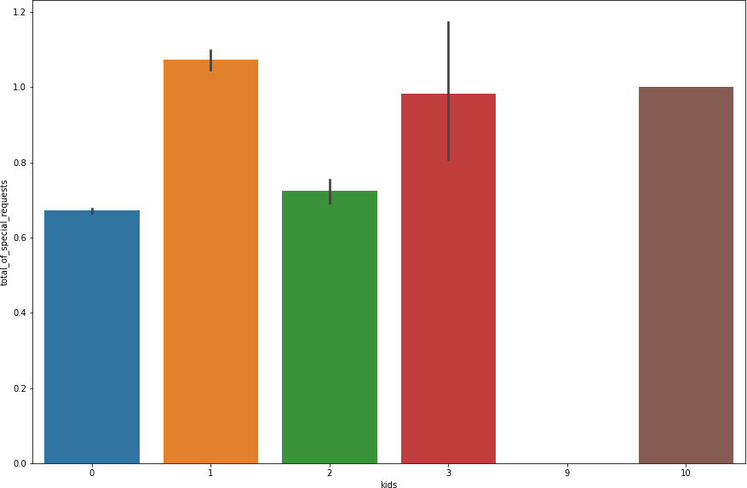
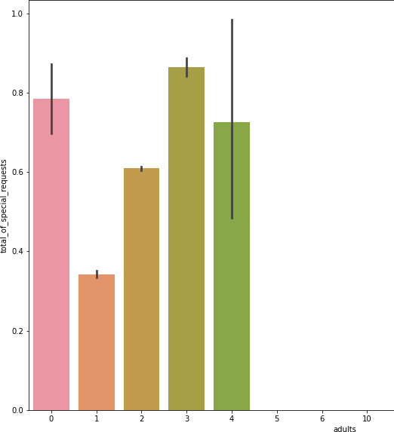
Reasons for special requests
The number of special request are almost the same in the kids section. But, we can see that if the adults are more than 2 there are more chances that hotels will receive more special requests.

Slide 21
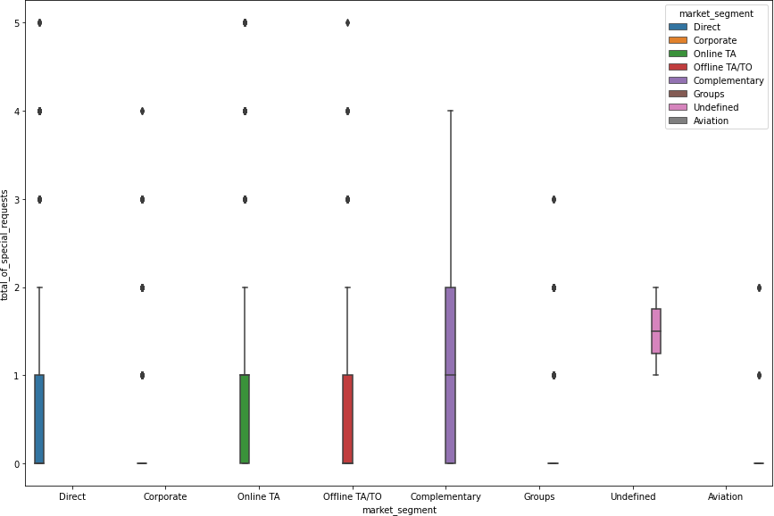
Reasons for special requests(cont.)
Here we can see that all market segment mostly have special request.
There is one segment which is complementary, having more than average number of special request.

Slide 22
Conclusion
Around 60% bookings are for City hotel and 40% bookings are for Resort hotel, therefore City Hotel is busier
than Resort hotel. Also the overall adr of City hotel is slightly higher than Resort hotel.
Mostly guests stay for less than 5 days in hotel and for longer stays Resort hotel is preferred.
Both hotels have significantly higher booking cancellation rates and very few guests less than 3 % return for another booking in City hotel. 5% guests return for stay in Resort hotel.
Most of the guests came from european countries, with most no. of guest coming from Portugal.
Guests use different channels for making bookings out of which most preferred way is TA/TO.
For hotels higher adr deals come via GDS channel, so hotels should increase their popularity on this channel.
Almost 30% of bookings via TA/TO are cancelled.
Not getting same room as reserved, longer lead time and waiting time do not affect cancellation of bookings.
Although different room allotment do lowers the adr.
July- August are the most busier and profitable months for both of hotels.
Within a month, adr gradually increases as month ends, with small sudden rise on weekends.
Couples are the most common guests for hotels, hence hotels can plan services according to couples needs to increase revenue.
More number of people in guests results in more number of special requests.
Bookings made via complementary market segment and adults have on average high no. of special request.
For customers, generally the longer stays (more than 15 days) can result in better deals in terms of low adr.

Slide 23
Thank You

